Slide 1
T = 0
...
T = 4
Build BEV maps
Intergrated
BEV features
Feature
Extractor
Multi-frame
point clouds
1x1 Conv
RoI Pooling
...
Fusion
...
3D Anchor
grid
...
Fused RoI features
RoI Pooling
FC
1x1 Conv
NMS
T = 0
Image features
...
Feature
Extractor
Single frame image
Top K 3D
Proposals

Slide 2
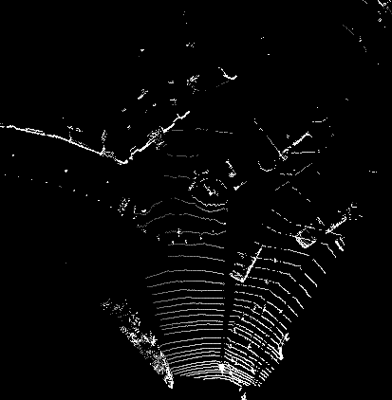
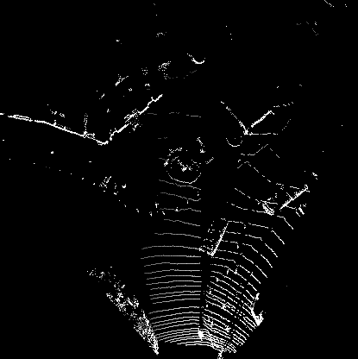
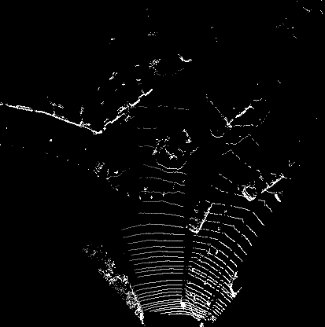
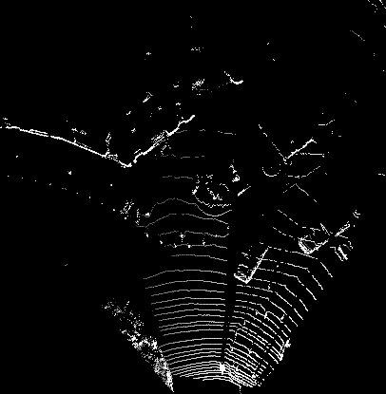
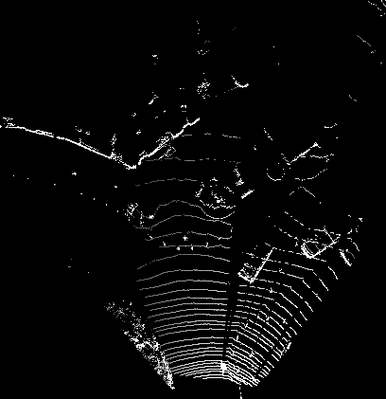
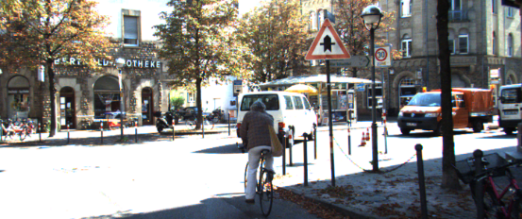
Create
BEV maps
3D Anchor grid
Feature
Extractor
Feature
Extractor
1x1 Conv
...
1x1 Conv
Intergrated
BEV features
Image features
...
RoI
Pooling
RoI
Pooling
Fusion
...
Fused RoI
features
FC
NMS
...
Top K 3D Proposals

Slide 3
BEV
maps
...
...
FC
Frame 0
Feature
Extractor
RoI Pooling
...
Fusion
z
Image
Fused features
NMS
x
Predictions
T = 0
Feature maps
Tracking Module
...
Correlation
FC
...
...
RPN
...
Correlation
features
NMS
z
Top K 3D Proposals
x
Offsets
BEV
maps
...
FC
Frame 1
...
Feature
Extractor
RoI Pooling
...
Fusion
Image
Fused features
NMS
z
T = 4
Feature maps
x
Predictions

Slide 4

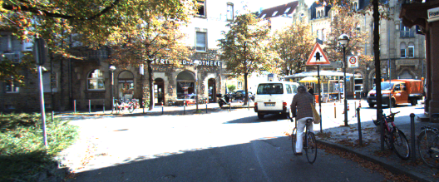

Slide 5
T = 0
...
T = 4
T = 0
Point
clouds
3D Anchor
grid
Image
Create
BEV maps
Feature
Extractor
Feature
Extractor
1x1 Conv
...
1x1 Conv
Intergrated
BEV features
...
Image features
RoI
Pooling
RoI
Pooling
Fusion
...
Fused RoI
features
FC
NMS
...
Top K 3D Proposals

Slide 6
BEV
maps
...
...
FC
Frame 0
Image
Feature
Extractor
RoI Pooling
...
Fusion
Fused features
NMS
Predictions
T = 0
Feature maps
Tracking Module
...
Correlation
FC
...
...
RPN
...
Correlation
features
NMS
Top K 3D Proposals
Offsets
BEV
maps
...
FC
Frame 1
...
Feature
Extractor
RoI Pooling
...
Fusion
Image
Fused features
NMS
z
T = 4
Feature maps
Y
x
Predictions

Slide 7
C
B
ry'
a'
θ'
Car 1'
Car 1
b'
c'
w
d'
D
ry
A
45°
l
a
Car 0
θ
b
c
Car 0'
d
z
E
O
x
F

Slide 8
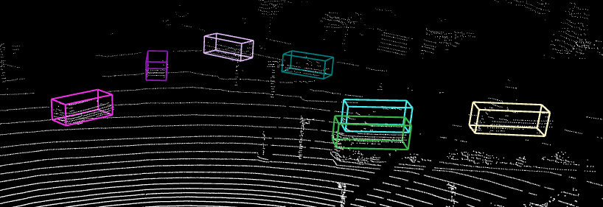
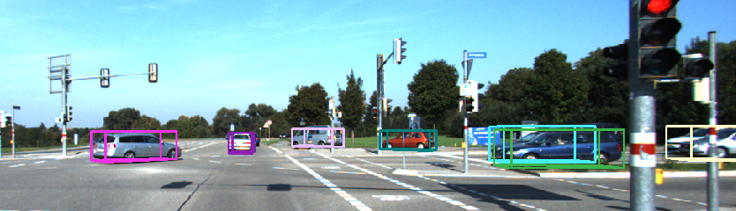
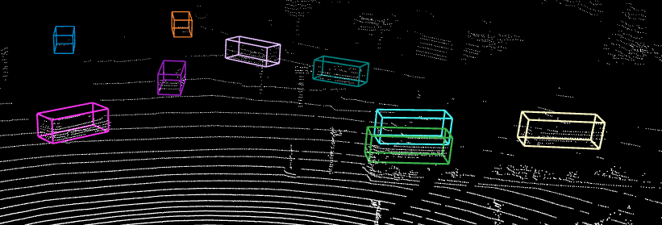
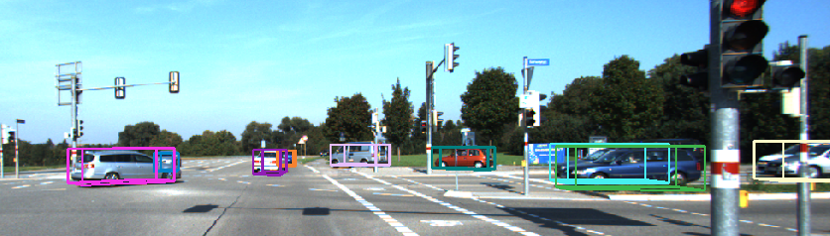
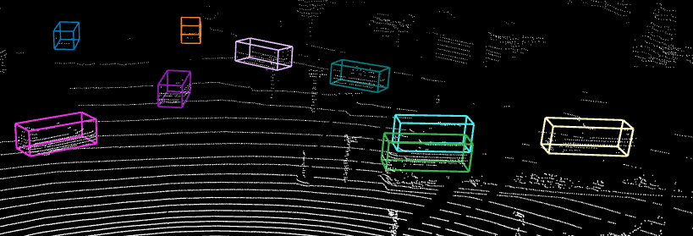
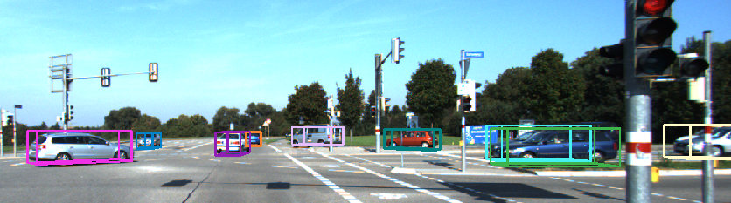
T = 2
T = 1
T = 0

Slide 9
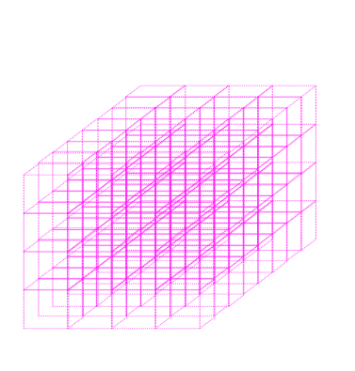
T = t ... t + τ
T = t
Create
BEV maps
3D Anchor
grid
Feature
Extractor
Feature
Extractor
1x1 Conv
...
1x1 Conv
Intergrated
BEV features
...
Image features
RoI
Pooling
RoI
Pooling
Fusion
...
Fused RoI features
FC
NMS
...
Top K 3D Proposals

Slide 10
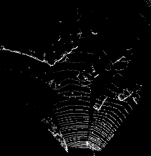


BEV
...
FC
...
Feature
Extractor
RoI Pooling
...
Fusion
Image
Fused features
NMS
Predictions
Keyframe: T = t
Feature maps
Temporal Module
...
Correlation
FC
...
...
Shared RPN
...
Correlation
features
NMS
Top K 3D Proposals
Offsets
...
FC
BEV
...
Feature
Extractor
RoI Pooling
...
Fusion
Image
Fused features
NMS
z
Keyframe: T = t + τ
Feature maps
Y
x
Predictions

Slide 11
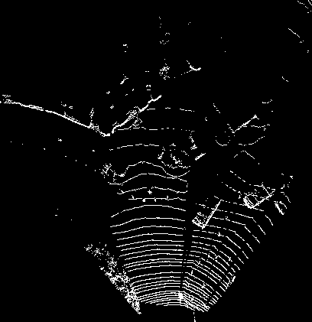
T = t ... t + τ
T = t
Create
BEV maps
3D Anchor grid
Feature
Extractor
Feature
Extractor
1x1 Conv
...
1x1 Conv
Intergrated
BEV features
...
Image features
RoI
Pooling
RoI
Pooling
Fusion
...
Fused RoI features
FC
NMS
...
Top K 3D Proposals

Slide 12
...
FC
BEV
...
Feature
Extractor
RoI Pooling
...
Fusion
Fused features
NMS
Image
Predictions
Keyframe: T = t
Feature maps
Temporal Module
...
Correlation
FC
...
...
Shared RPN
...
Correlation
features
NMS
Top K 3D Proposals
Offsets
...
FC
BEV
...
Feature
Extractor
...
Fusion
NMS
Image
RoI Pooling
Fused features
z
x
Predictions
Keyframe: T = t + τ
Feature maps

Slide 13
...
FC
BEV
...
Feature
Extractors
RoI Pooling
...
Fusion
Fused features
NMS
Image
Predictions
Keyframe: T = t
Feature maps
Temporal Module
...
Correlation
FC
...
...
Shared RPN
...
Correlation
features
NMS
Top K 3D Proposals
Offsets
...
FC
BEV
...
Feature
Extractors
...
Fusion
NMS
Image
RoI Pooling
Fused features
z
x
Predictions
Keyframe: T = t + τ
Feature maps

Slide 14
...
FC
BEV
...
Feature
Extractor
RoI Pooling
...
Fusion
Fused features
NMS
Image
Predictions
Keyframe: T = t
Feature maps
Temporal Module
...
Correlation
FC
...
...
Shared RPN
...
Correlation
features
NMS
Top K 3D Proposals
Offsets
...
FC
BEV
...
Feature
Extractor
...
Fusion
NMS
Image
RoI Pooling
Fused features
z
x
Predictions
Keyframe: T = t + τ
Feature maps

Slide 15
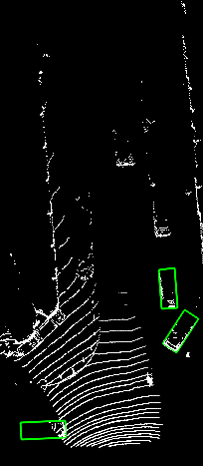
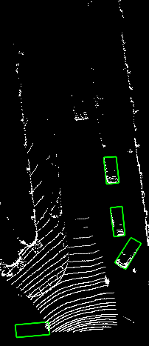
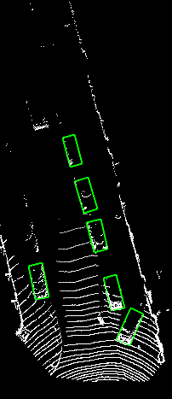
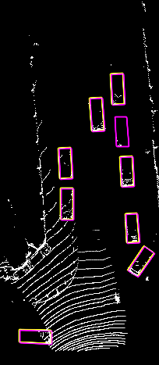
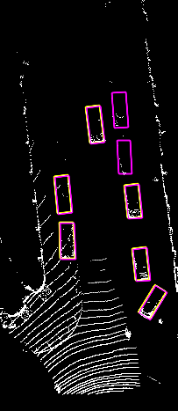
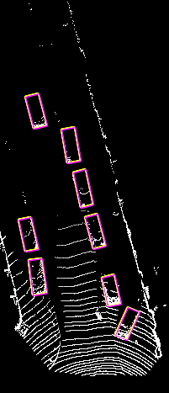
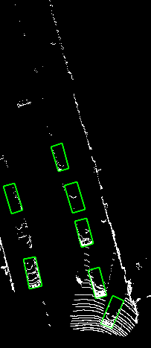
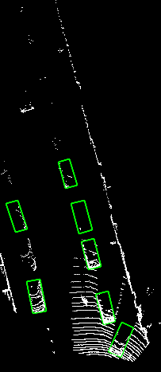
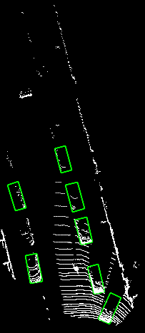
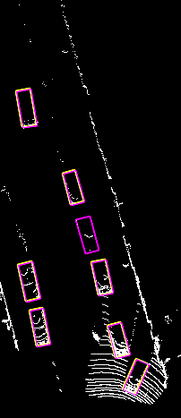
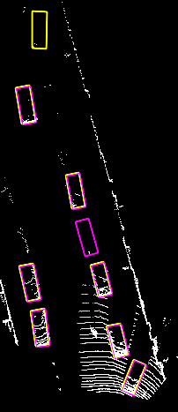
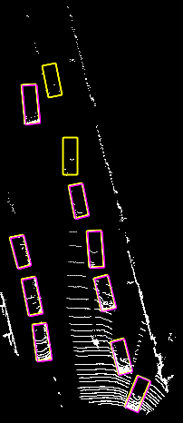
Frame 118
Frame 120
Frame 128
Frame 134
Frame 135
Frame 136

Slide 16
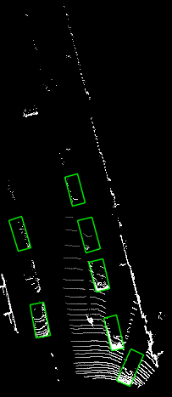
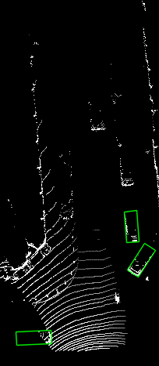
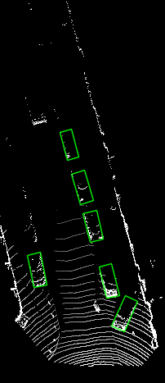
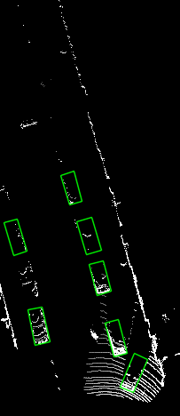
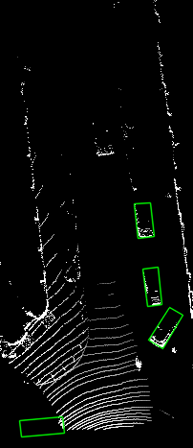
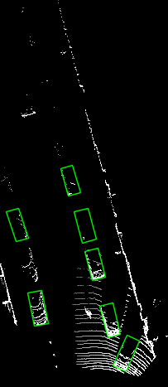
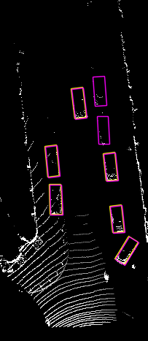
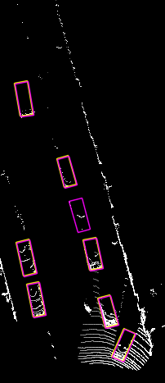
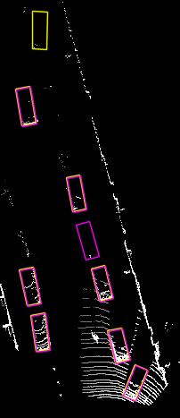
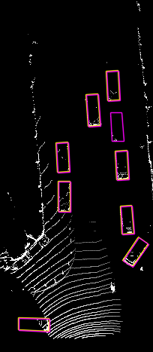
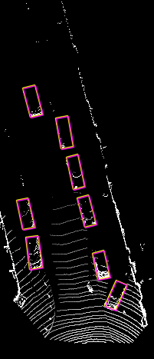
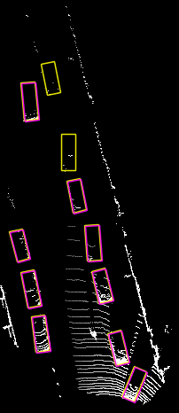

Slide 17
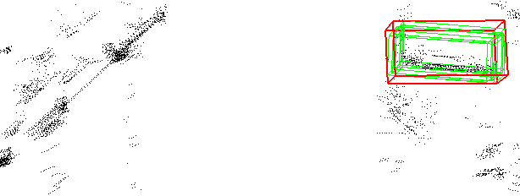
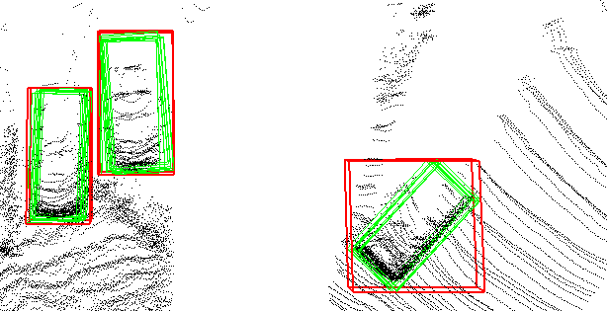

Slide 18
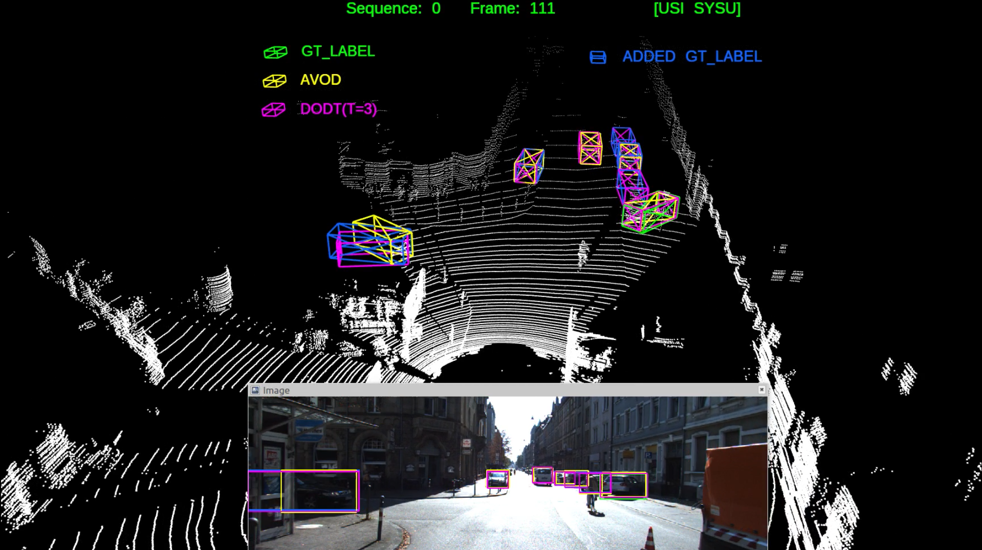
Predictions match
added gt_label
Prediction matches
official gt_label

Slide 19

3D Object Detection and Tracking
Based on Streaming Data
Xusen Guo, Long Cheng, Kai Huang et al., Sun Yet-Sen University
2019/09/21

Slide 20
Visualization of 3D Object Detection Results
on KITTI Object Tracking Validation Datasets
* Boxes in green are official ground truth provided by KITTI, while boxes in blue are additional
ground truth we added manually.

Slide 21
Visualization of Multiple Object Tracking Results
on KITTI Object Tracking Test Datasets

Slide 22
Visualization of 3D object detection results and multiple object tracking results
of several sequences on KITTI object tracking validation datasets.
We visualize three comparisons in this video:
① DODT (T = 3) + AVOD + GT
② DODT (T = 3) + DODT (T = 1) + GT
③ DODT (T = 3) + based model of DODT (T = 3) + GT
① shows the comparison of our model with original AVOD model
② shows the effect of temporal stride T on model performance
③ shows the effect of Temporal Module and our interpolation algorithm

Slide 23
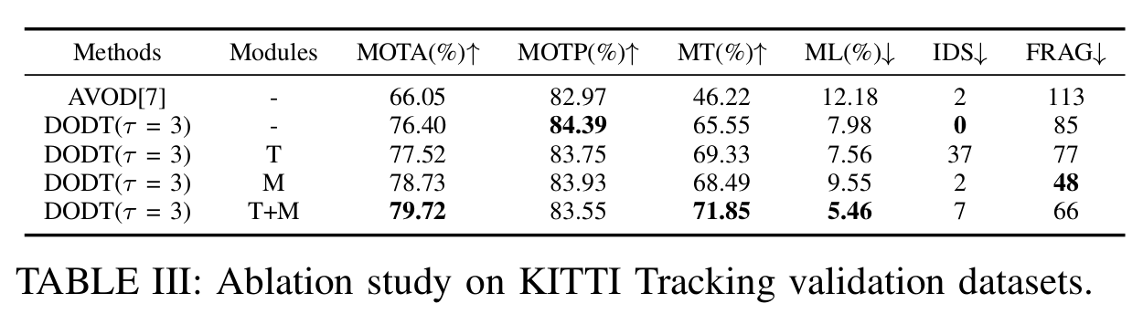
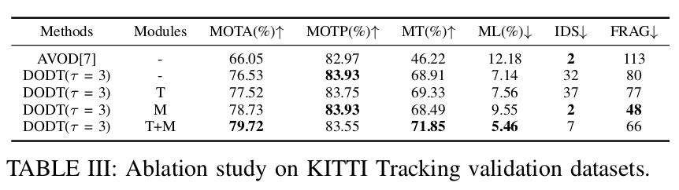
Correction
During making this video, We find that one of our results in TABLE III
(marked in orange) is incorrect. We are so sorry for our careless, and
the corrected version is given following (marked in green):
×
√

Slide 24
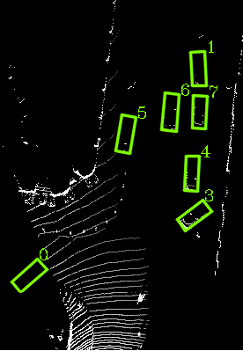
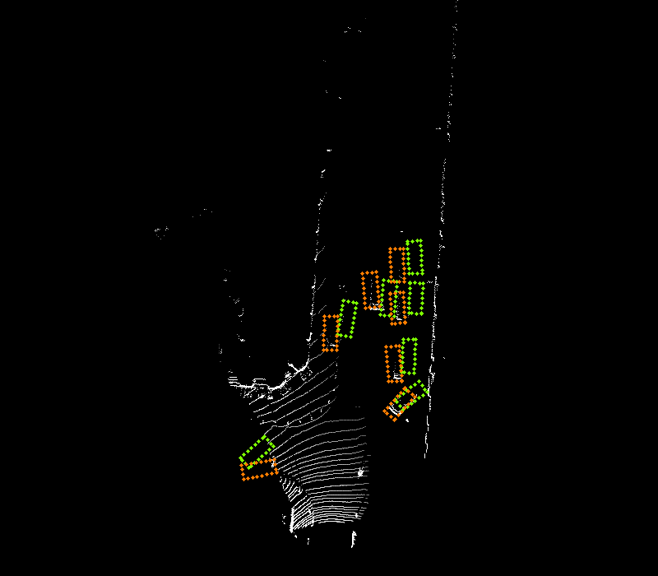
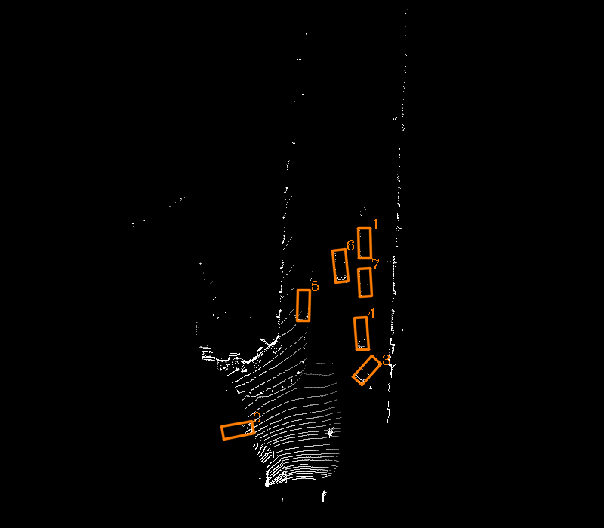
DODT only performs object detection on keyframes, and the results of non-key frames
are generated by our interpolation algorithm.
Keyframes are selected with a temporal stride 3 (e.g. 0, 3, 6, ...) in this example.
Frame 108
Frame 109 - 110
Frame 111
Keyframe
Non-key frames
Keyframe
Timeline

Slide 25
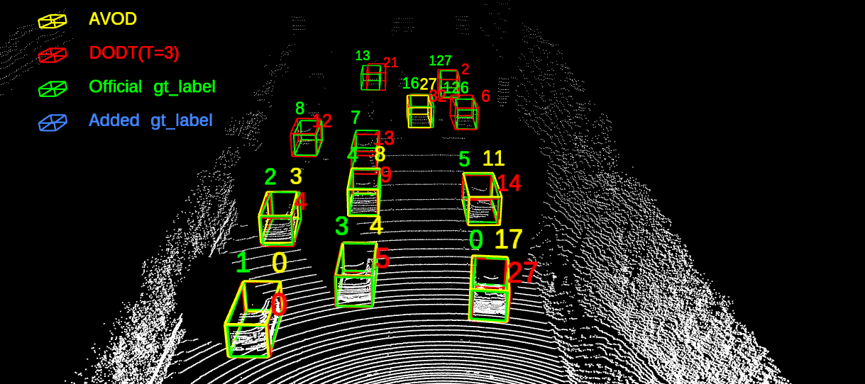
Comparisons of DODT (T = 3), AVOD and ground truth on our
KITTI object tracking validation datasets.
* Ground truth includes the labels we added manually.
Sequence 20, Frame 6
DODT performs much better
than origin AVOD model

Slide 26
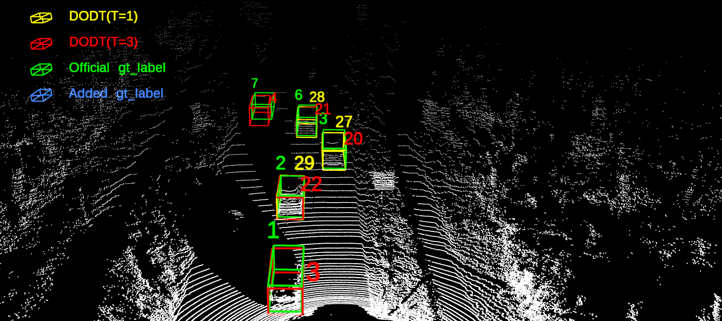
Comparisons of DODT (T = 3), DODT (T = 1) and ground truth on our
KITTI object tracking validation datasets.
* Ground truth includes the labels we added manually.
Sequence 18, Frame 153
DODT works better with
larger temporal stride

Slide 27

Comparisons of DODT(T = 3), Based_DODT (T = 3) and ground truth on our
KITTI object tracking validation datasets.
* Ground truth includes the labels we added manually.
* Based_DODT: DODT model without Temporal module and Motion based interpolation algorithm.
Sequence 4, Frame 208
DODT performs better
with track extension

Slide 28
THANK YOU !

